Slide 1
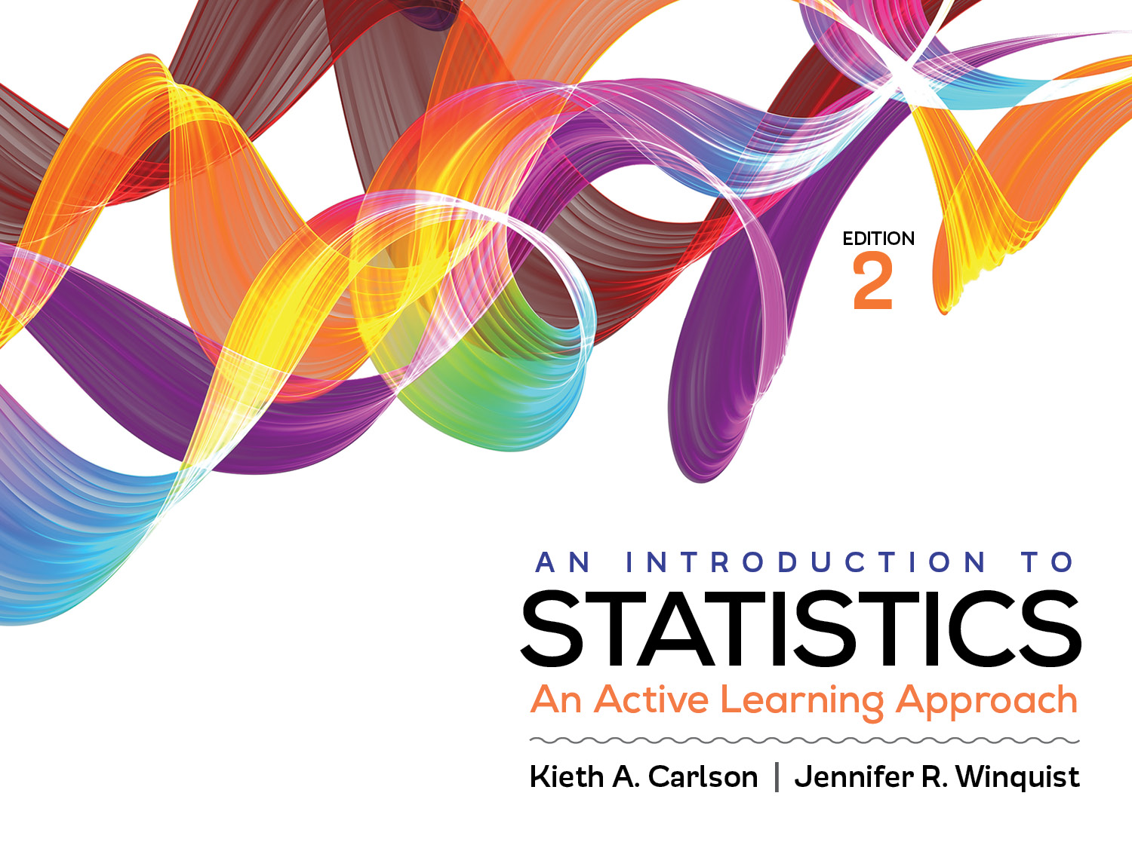
Introduction to Activity 6.4
Hypothesis testing and effect size

Slide 2
Activity 6.4 will require you to:
Conduct a hypothesis test using the z for a sample mean
Distinguish between Type I and Type II errors

Slide 3
Self test and explain
For the next few slides, answer the questions by writing down your answer on a sheet of scratch paper. When I ask you to, hold up 1 finger if you think the answer to a question is A, two fingers if it is B, etc.
If you do not visibly show your answer, I will call on you. You have to participate.

Slide 4
Hypothesis testing vs. effect size
Answer this question: The results of a hypothesis test:
indicate whether or not the study’s outcome is likely or unlikely to be do to sampling error.
quantify how much the treatment changed scores in standard deviation units
Answer this question: The results of an effect size:
indicate whether or not the study’s outcome is likely or unlikely to be do to sampling error.
quantify how much the treatment changed scores in standard deviation units
Show your answers. Now find someone who chose different answers and discuss both questions. Try to explain your reasoning to each other. After the discussion, I will ask you to answer these questions a second time.
Notes:
First question is A
Second question is B

Slide 5
Type I error vs. Type II error
Which of the following describes a Type I error? (Choose all that apply)
a) Saying a treatment works when it does not
b) Rejecting the null when you should not have
c) Saying there was a significant mean difference when it was actually caused by sampling error
d) Saying a treatment does NOT work when it does
e) Failing to reject the null when you should have
f) Saying there was NOT a significant mean difference when the treatment actually does work
Compare your answer(s) with someone and come to an agreement on what is correct.
Notes:
Answer is: A, B, and C

Slide 6
Type I error vs. Type II error
Which of the following describes a Type II error? (Choose all that apply)
a) Saying a treatment works when it does not
b) Rejecting the null when you should not have
c) Saying there was a significant mean difference when it was actually caused by sampling error
d) Saying a treatment does NOT work when it does
e) Failing to reject the null when you should have
f) Saying there was NOT a significant mean difference when the treatment actually does work
Compare your answer(s) with someone and come to an agreement on what is correct.
Notes:
Answer is D, E, and F

Slide 7
Type I error vs. Type II error
If a researcher rejected the null hypothesis they
a) definitely made a Type I error
b) definitely made a Type II error
c) might have made a Type I error
d) might have made a Type II error
Find someone who chose differently and discuss your answer. I will ask you to vote again.
Notes:
C

Slide 8
Type I error vs. Type II error
If a researcher did not reject the null hypothesis they
a) definitely made a Type I error
b) definitely made a Type II error
c) might have made a Type I error
d) might have made a Type II error
Find someone who chose differently and discuss your answer. I will ask you to vote again.
Notes:
D

Slide 9
Helpful hints
This activity will give you a chance to determine if you understand all of these concepts in the context of a research scenario.
As always, I encourage you to work together. Explaining your reasoning to others can help you and them.

